Slide 1

Design and Development of a RAM-based PUF
Zissis Tabouras (s284685)
Elena Roncolino (s304719)
Stefano Palmieri (s281677)

Slide 2
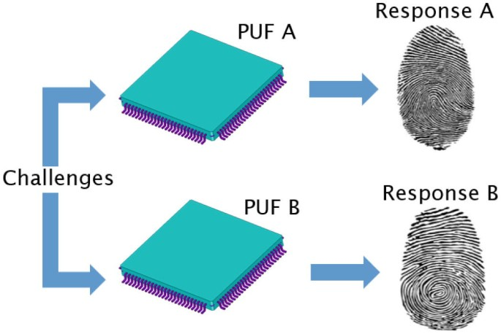
Why is a PUF?
2

Slide 3
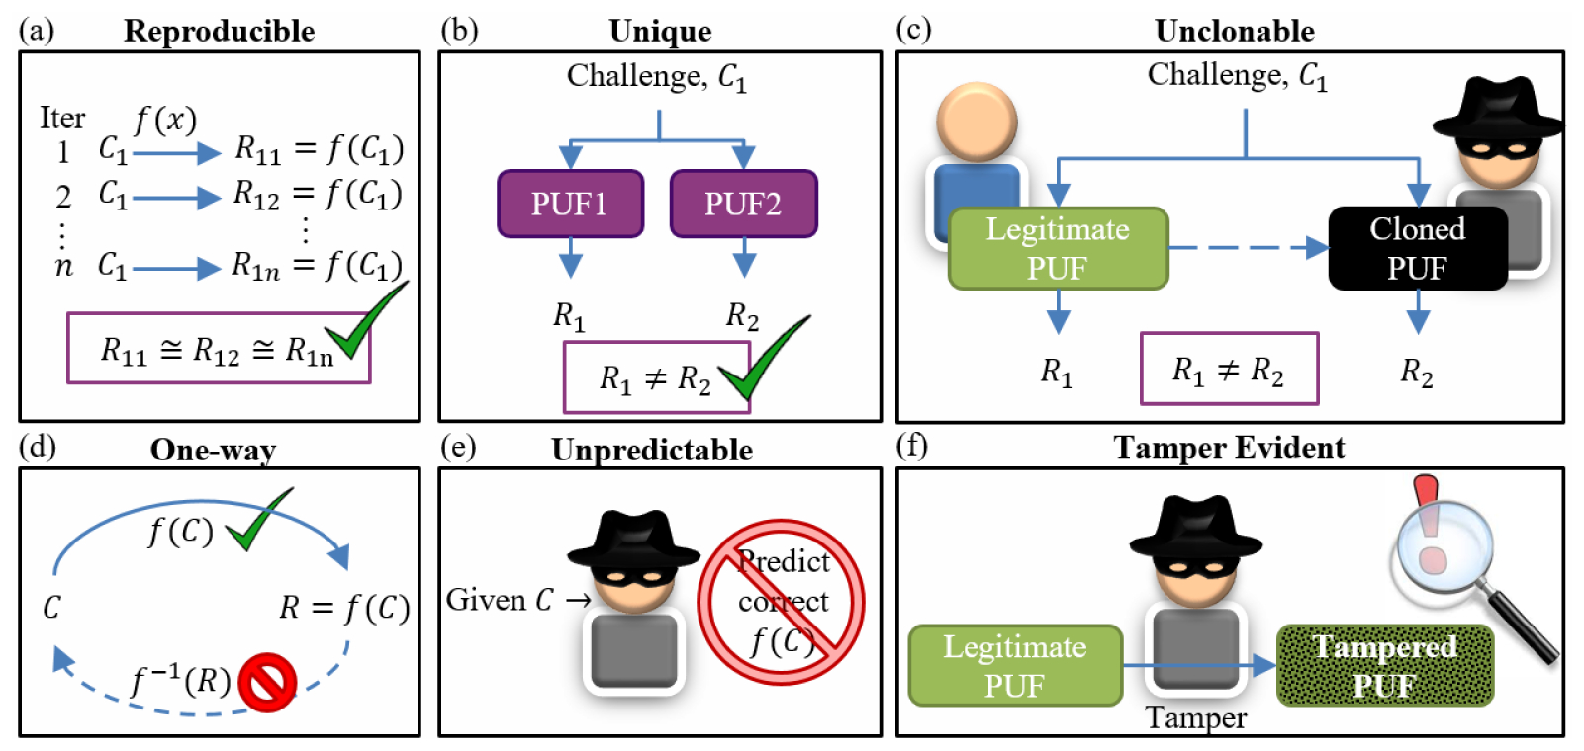
Why is PUF important?
3

Slide 4
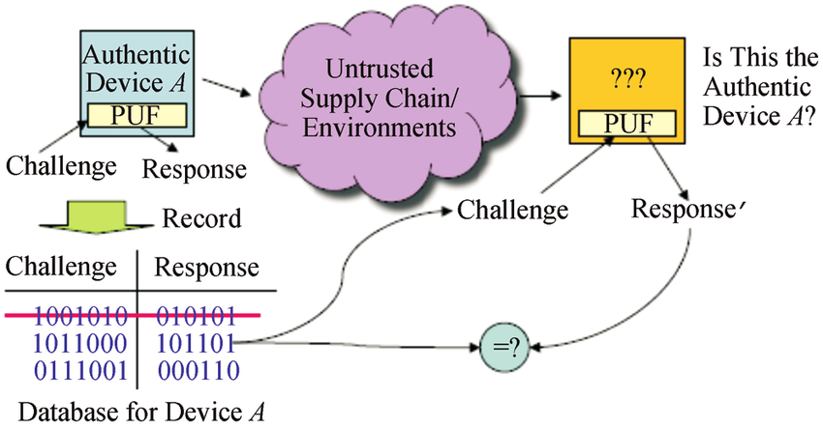
How PUF works?
4

Slide 5
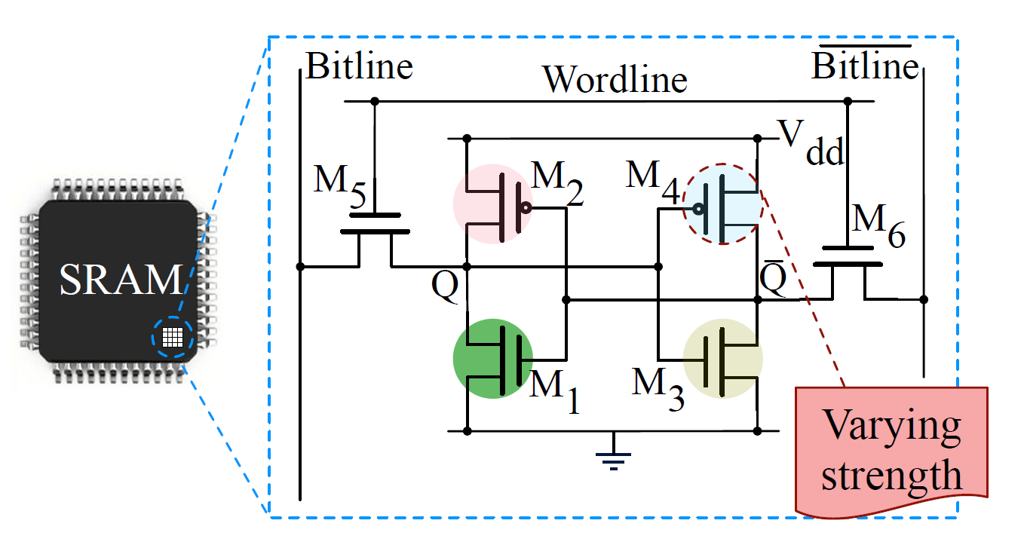
PUF implemented
5

Slide 6
Implementation

Slide 7
Implementation
Two flow: 1. host retrieving all the responses from the device 2. challenge-response authentication mechanism between the host and the device
7
Notes:
Store SRAM content into flash memory
Access flash memory to retreive PUFs
Store PUFs in DB

Slide 8
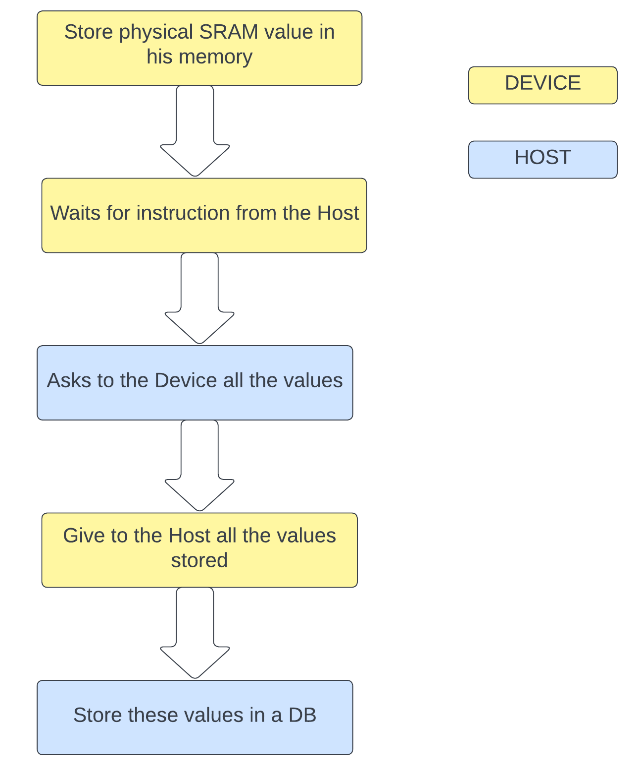
First flow
Host
Request list of PUFs
Receive PUF list
Store the list in a DB
Device
Store SRAM content in FLASH(startup)
Send list of PUFs
Notes:
PUF retrieval and DB initialization
Store SRAM content into flash memory
Access flash memory to retreive PUFs
Store PUFs in DB

Slide 9
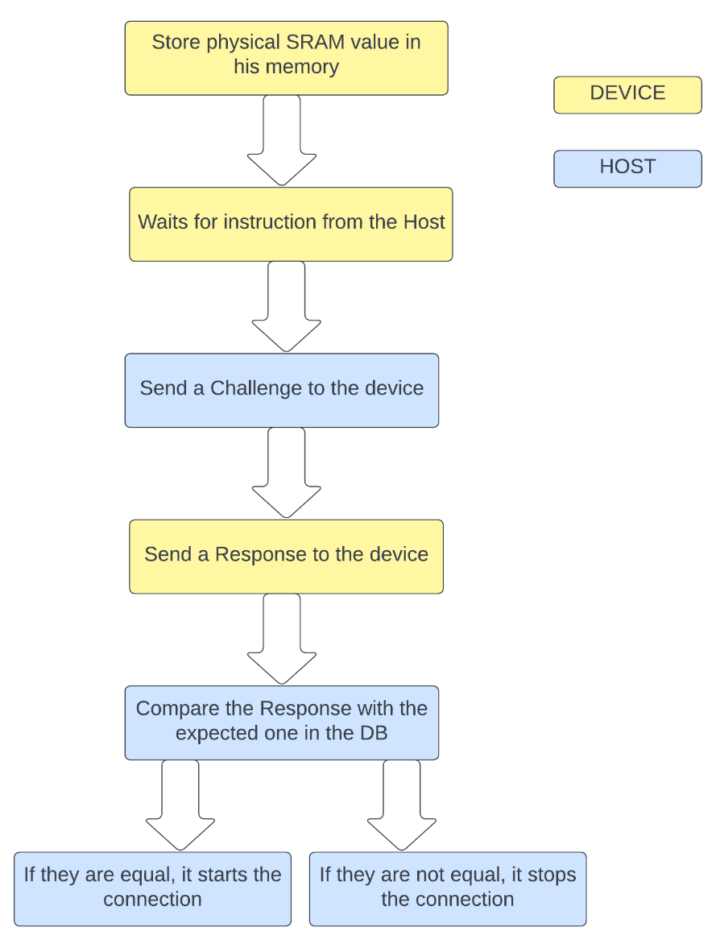
Second Flow
Host
Generate challenge
Send challenge to Board and DB
Compare responses (Hamming)
Device
Receive challenge
Send response
Notes:
Application of a challenge and verification of device authenticity
Apply challenge to DB and board
Retreive board response
Perform response matching

Slide 10
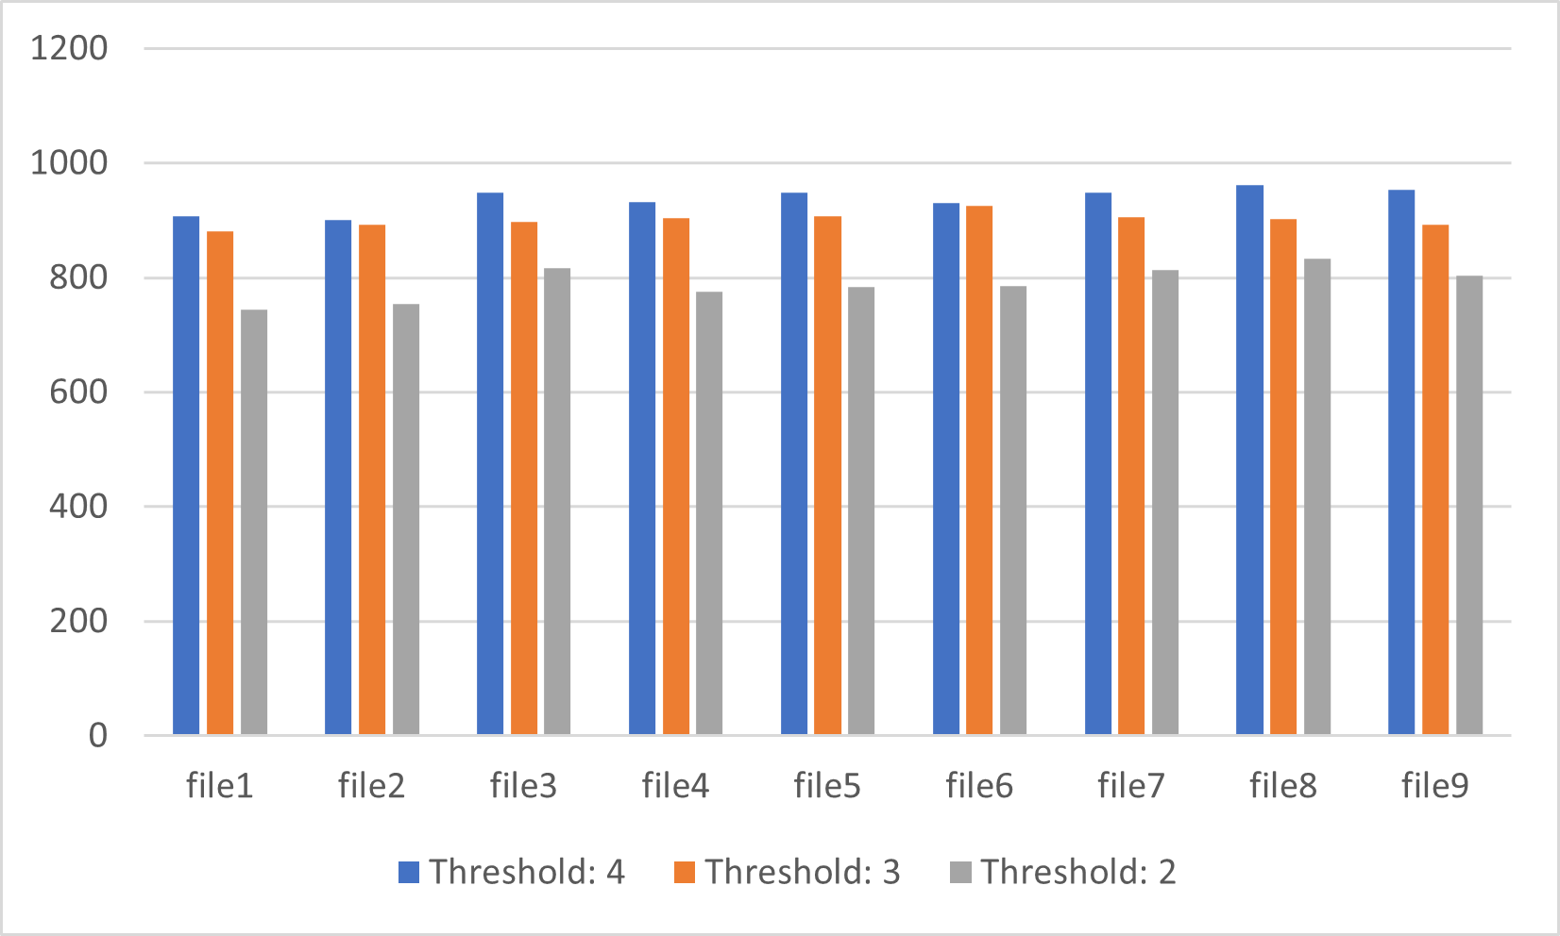
Results
Thresholds:
2 -> 79,00% of accurancy
3 -> 90,10% of accurancy
4 -> 93,67% of accurancy

Slide 11
Example on the board

Slide 12
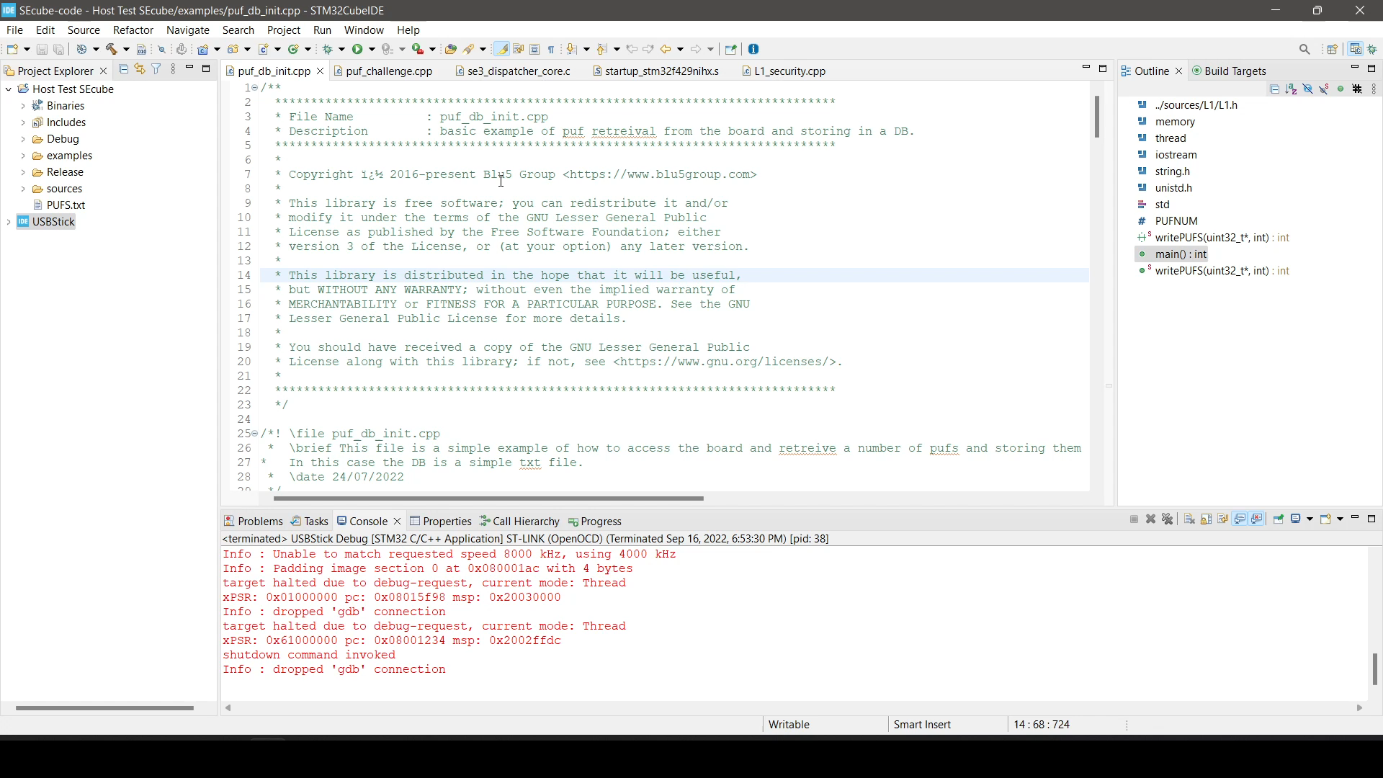
Flow 1

Slide 13
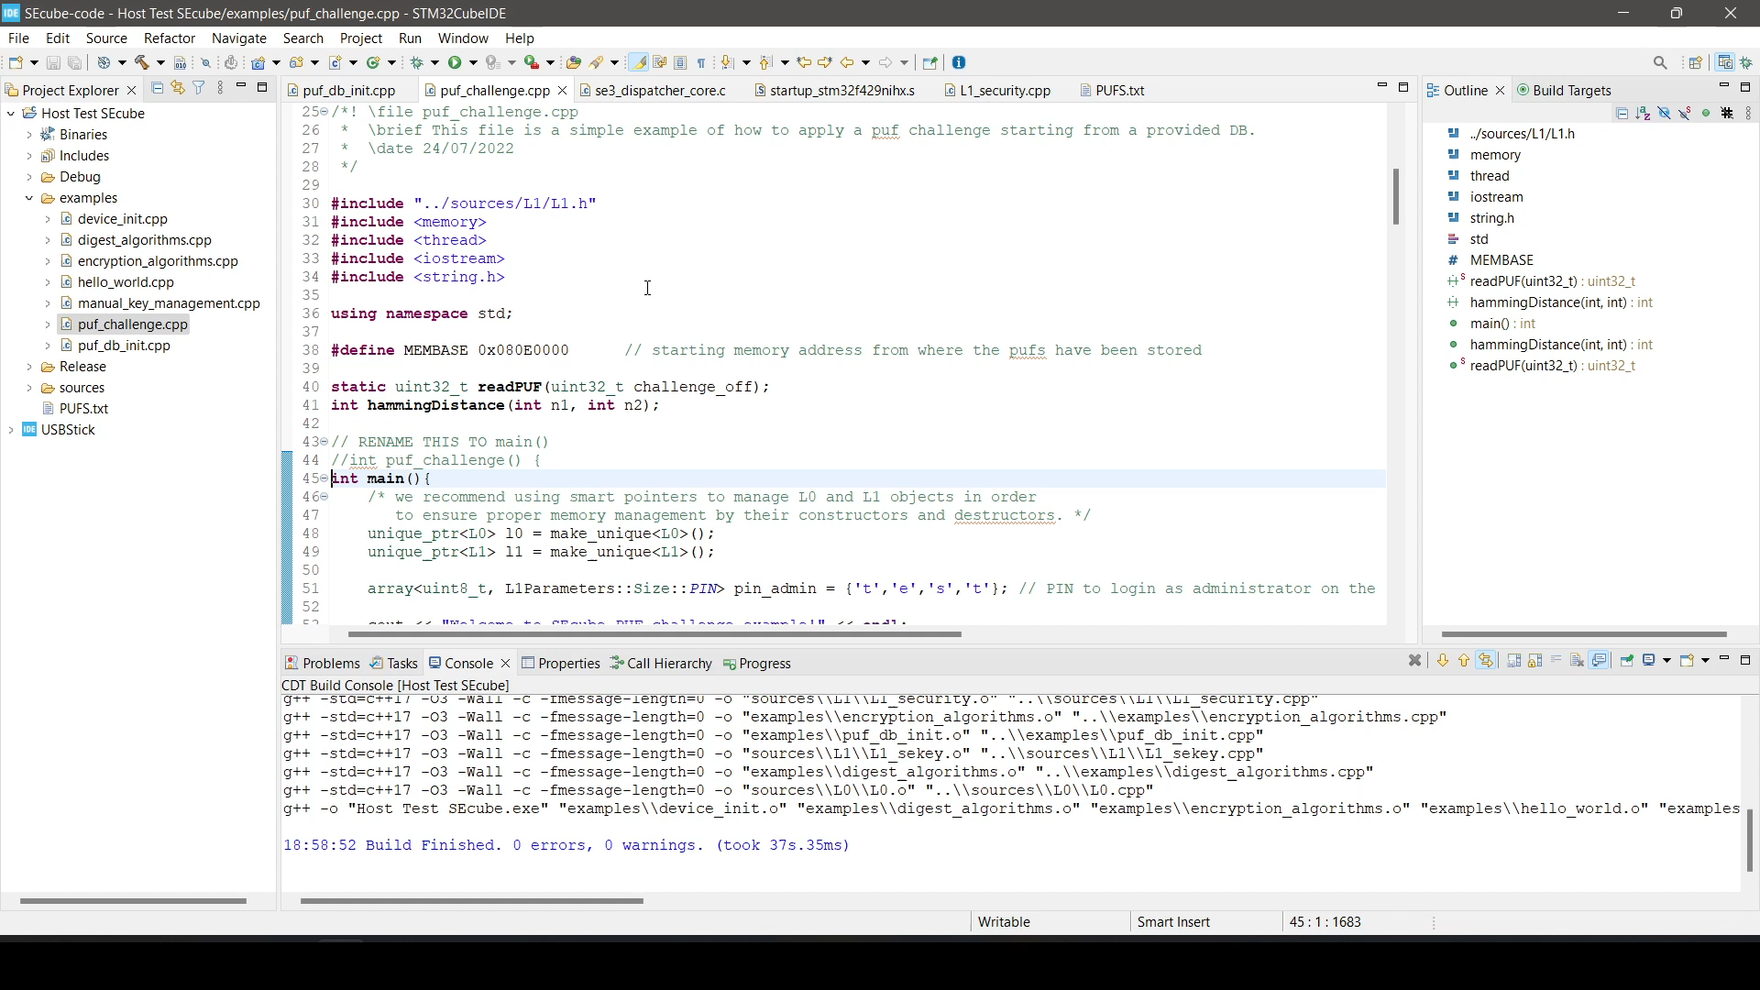
Flow 2

